Slide 1
Massively Parallel Monte Carlo for Lennard-Jones System
Course Project for MSE 485
By Konik Kothari, Ankit Verma and Qing Ye

Slide 2
Motivation
Traditional Monte Carlo calculation is computationally expensive because the energy calculation scales quadratically with the number of particles in the system
The GPU offers cheap and yet substantial computing power
What we need is not parallelism but massive parallelism

Slide 3


Motivation
VS
Example: Nvidia GTX 780 Ti
$400 for 5 TFLOPS
2,880 Cores
Example: Intel i7 4770K
$300 for 0.18 TFLOPS
4 cores

Slide 4
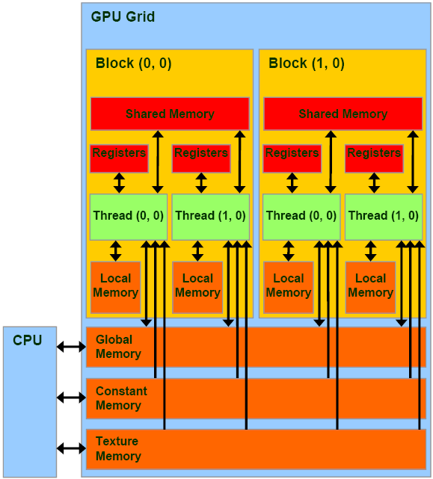
GPU Architecture (CUDA)

Slide 5
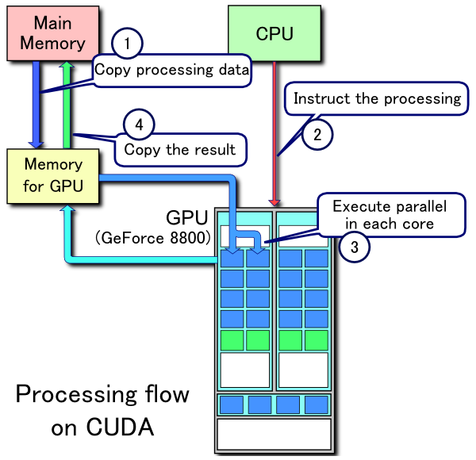
CUDA Processing Flow
CUDA Processing flow
Copy data from main RAM to the GPU memory
CPU instructs the process to GPU
GPU executes in parallel
Copy the result from GPU memory to main memory

Slide 6
Key Constraints When Writing GPU Code
Utilize as many threads concurrently as possible
Must avoid race conditions
Must consider the trade off between concurrency vs overhead
Access memory efficiently
Shared memory is fast but has very limited space (48KB)
Global memory (GPU) is only efficient when locality is preserved. Random access is extremely inefficient
The language itself is low level
Cannot make standard C library calls from GPU code
No debug information available

Slide 7
Algorithm: Overview
Divide the space into cells and put the cells into different checkerboard groups
For each MC Step do:
Shuffle the groups
For each group do:
For each cell in the group, in parallel do:
Shuffle particles in the cell
Perform Metropolis Monte Carlo for particles in the cell
Shift the boundaries of the cells and reassign particles

Slide 8

Algorithm: Checkerboard Decomposition
Width of cell is no less than the cutoff distance
Cells are divided into groups similar to a checkerboard (but in 3D)
In each group, no two cells are adjacent to each other
Perform Monte Carlo moves in cells of the same group concurrently
Groups cannot be processed concurrently
8 checkerboard groups in 3D

Slide 9
Algorithm: Subsweep Step
For each cell in the Group, run in parallel
Randomize the ordering of the particles
For each particle in the cell
Propose a move
Reject if move out of the cell
Calculate energy using particles in the cell and particles in neighboring cells
Accept with Metropolis Monte Carlo criterion

Slide 10
Subsweep Implementation Version I
Parallelism design:
Assign all cells in a checkerboard group to the same block
Launch a thread for each cell in the group
The rest of the calculation for this cell, including energy calculation will be handled by this thread
Memory Usage Design:
For each thread, positions of particles in the cell is read into the shared memory (but different thread will use different shared memory location)
Store the updated positions back to global memory when all moves in the MC step are done for the cell
When calculating energy change, positions of particles from neighboring cells are read from global memory (can only rely on hardware cache for performance)

Slide 11
Drawbacks of Implementation Version I
Not enough parallelism
Two few threads (# of cells/8) run concurrently
Will require millions of particles in order to utilize the full potential of the GPU
Mostly random global memory access
50-100x slower than coalesced memory access
Shared memory may not be big enough to store positions of all the particles within a checkerboard group

Slide 12
Subsweep Implementation Version II
Parallelism design:
Assign each cell to a CUDA block
Launch up to 1000 threads per block
Moves are proposed in serial but the pairwise energy calculations are done concurrently
Memory Usage Design:
Read positions of particles in the cell and in the neighbors of the cell and write to the Shared memory

Slide 13
Algorithm: Cell Shift Step
Choose a random direction (x, y, or z)
Choose a random distance uniformly distributed between –w/2 and w/2 (w: cell-width)
Move the cell grid
Assign particles to the new cell grid again

Slide 14
Benchmark
Benchmark Run for Version II
1,000 atoms
1,000 MC sweeps
1,280 moves per sweep (20 moves per cell per sweep)
Result
57 seconds
Serial version on CPU would take at least 3 hours (by scaling the time needed from the 64 atoms in the homework)
https://www.youtube.com/watch?v=citkhhgsVwI&feature=youtu.be

Slide 15
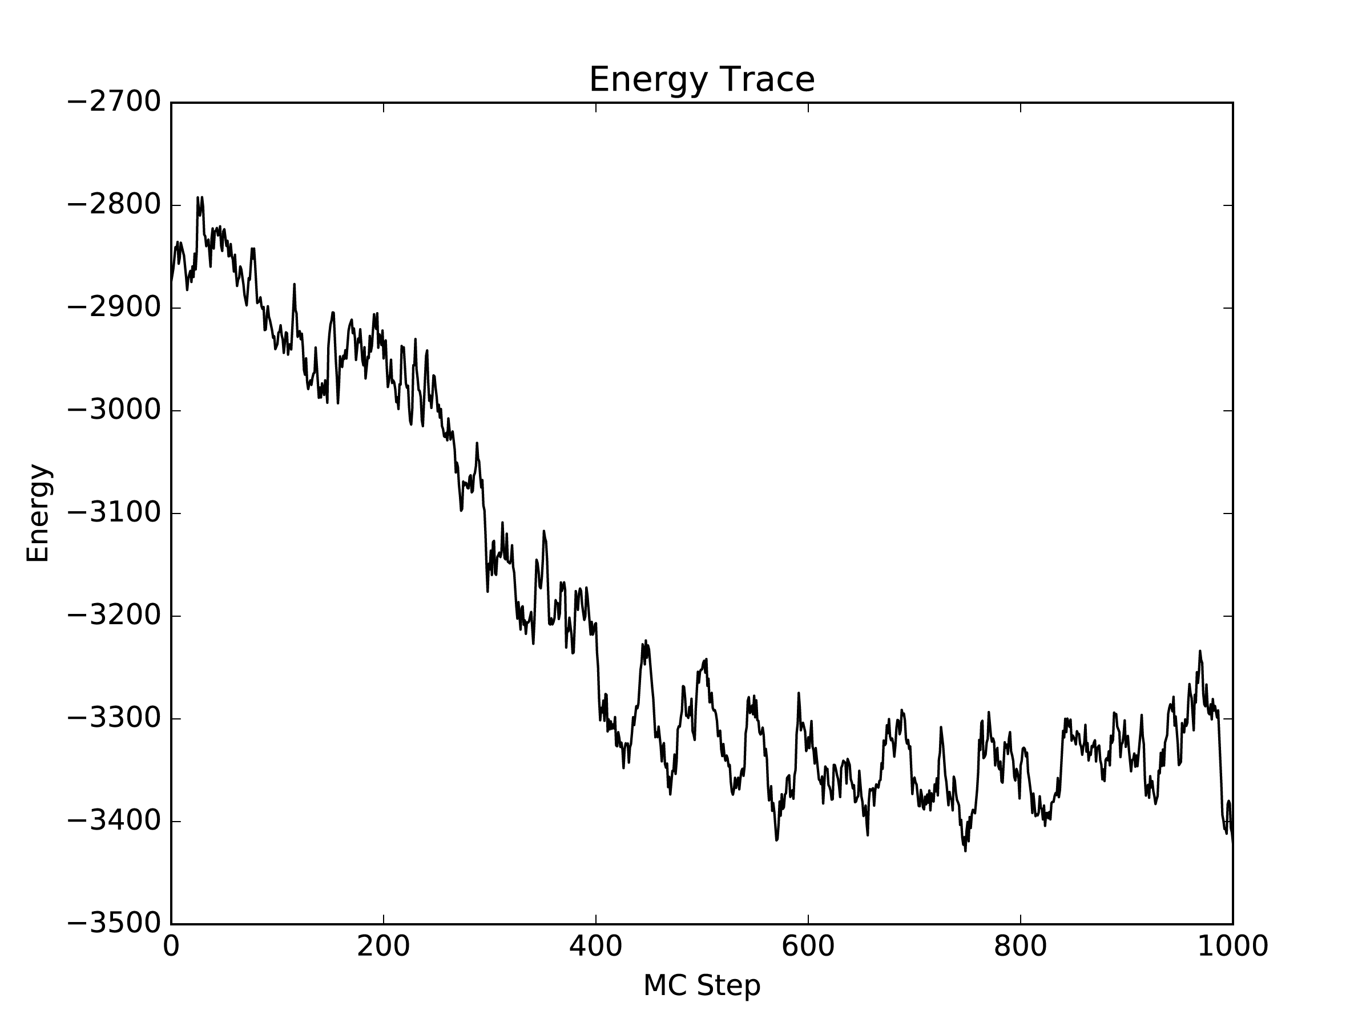
Results
1000 atoms
1000 MC sweeps
1280 moves per sweep (20 moves per cell/sweep)

Slide 16
Detailed Balance
Particles are not allowed to leave the cell otherwise the reverse step cannot be performed
To ensure ergodicity, cells are shifted
Particles are shuffled before the subsweep step, otherwise the temporal memory of the previous step will be built over the sweeps
Checkerboard sets are shuffled so the reverse sweep can be generated

Slide 17
References
J. Andersion et al. “Massively parallel Monte Carlo for many-particle simulations on GPUs”, Journal of Computational Physics. Vol. 254. Dec 1, 2013. pp 27 – 38
D. Kirk, W. Hwu “Programming Massively Parallel Processors”, 1st Ed., Morgan Kauffman Publishers, 2010 (Chapters 4-7)
Source for GPU architecture: http://www.realworldtech.com/includes/images/articles/g100-2.gif
CUDA Processing Flowing figure from: https://en.wikipedia.org/wiki/CUDA#/media/File:CUDA_processing_flow_(En).PNG (CC BY 3.0)
Icon set (GPU and CPU) from www.flaticon.com

